Slide 1


Azərbaycan Dövlət Neft və Sənaye Universiteti
Calculus
Single Variable

Slide 2
Partial Fractions

Slide 3
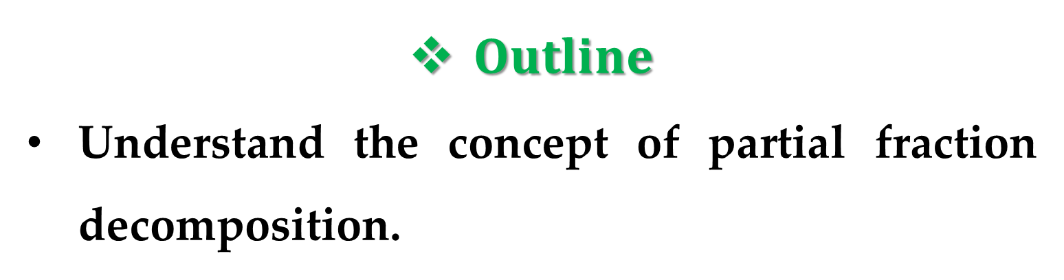
$Outline$
Understand the concept of partial fraction decomposition.
Use partial fraction decomposition with linear factors to integrate rational functions.
Use partial fraction decomposition with quadratic factors to integrate rational functions.

Slide 4
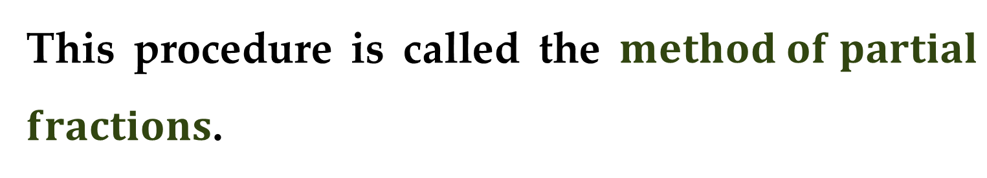
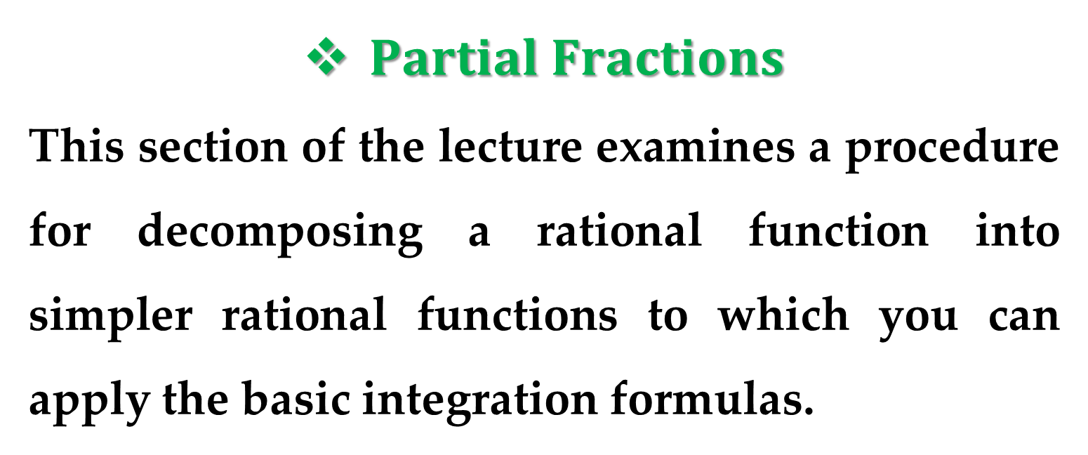
$Partial Fractions$
This section of the lecture examines a procedure for decomposing a rational function into simpler rational functions to which you can apply the basic integration formulas.
This procedure is called the $method of partial$ $fractions$.

Slide 5
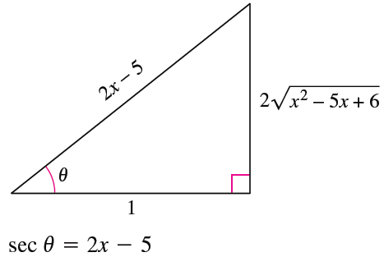
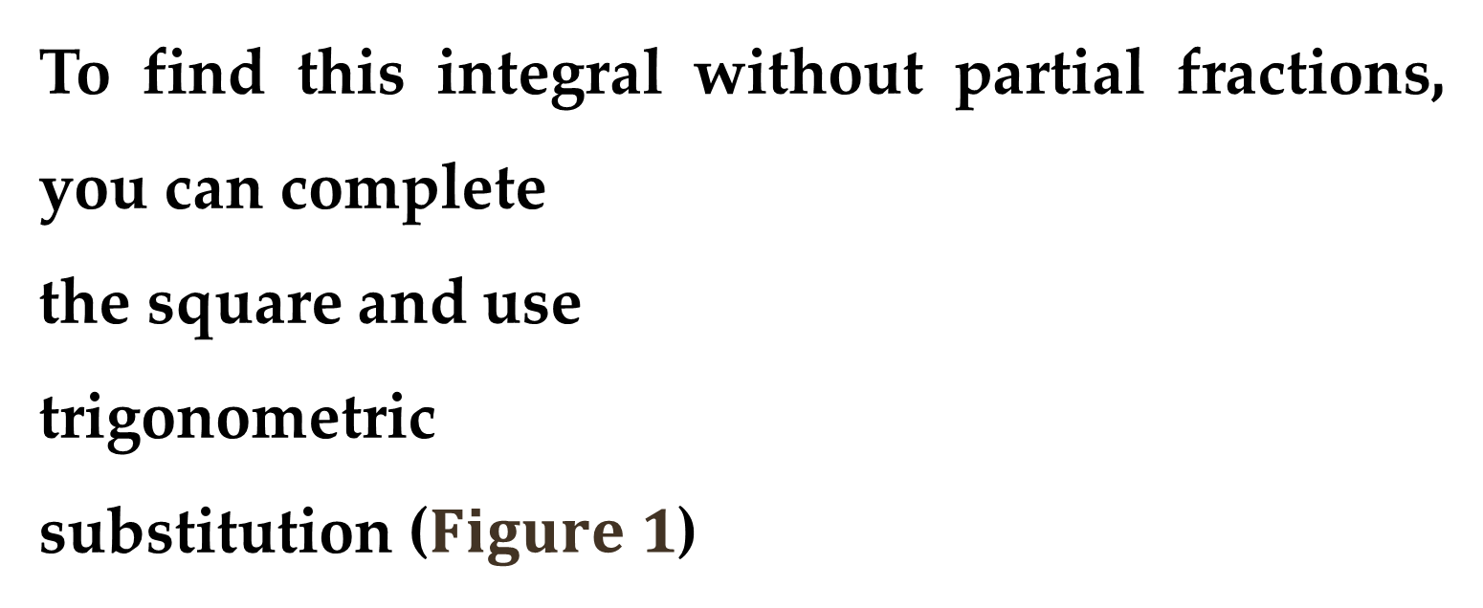
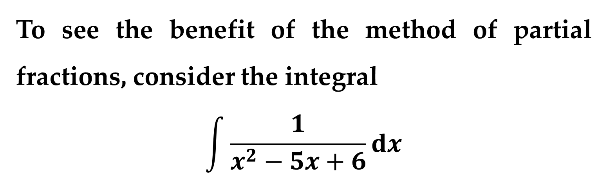
To see the benefit of the method of partial fractions, consider the integral
$$\int{\frac{1}{x^{2}−5x+6}dx}$$
To find this integral without partial fractions, you can complete
the square and use
trigonometric
substitution ($Figure 1$)

Slide 6
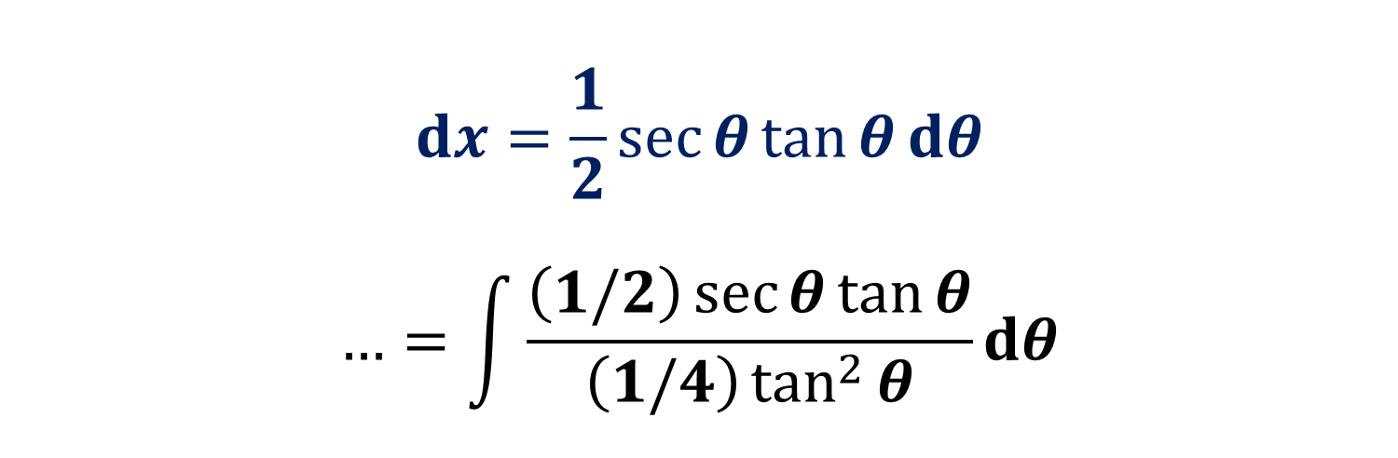
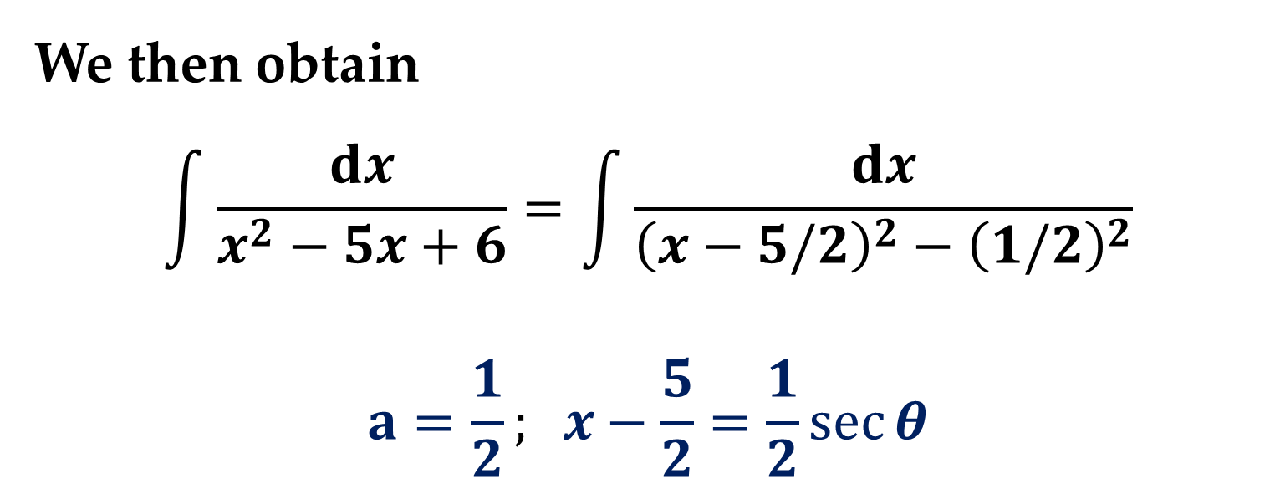
We then obtain
$$\int{\frac{dx}{x^{2}−5x+6}}=\int{\frac{dx}{{\left(x−5/2\right)}^{2}−{\left(1/2\right)}^{2}}}$$
$$a=\frac{1}{2}; x−\frac{5}{2}=\frac{1}{2}\sec{θ}$$
$$dx=\frac{1}{2}\sec{θ}\tan{θ}dθ$$
$$…=\int{\frac{\left(1/2\right)\sec{θ}\tan{θ}}{\left(1/4\right)\tan^{2}{θ}}dθ}$$

Slide 7
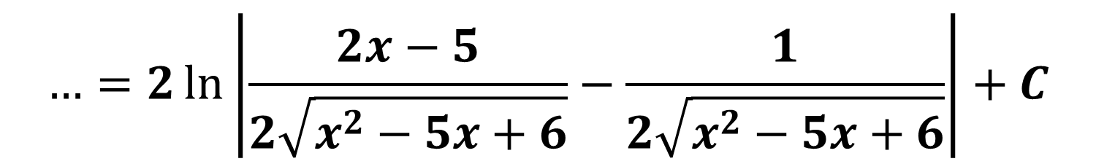
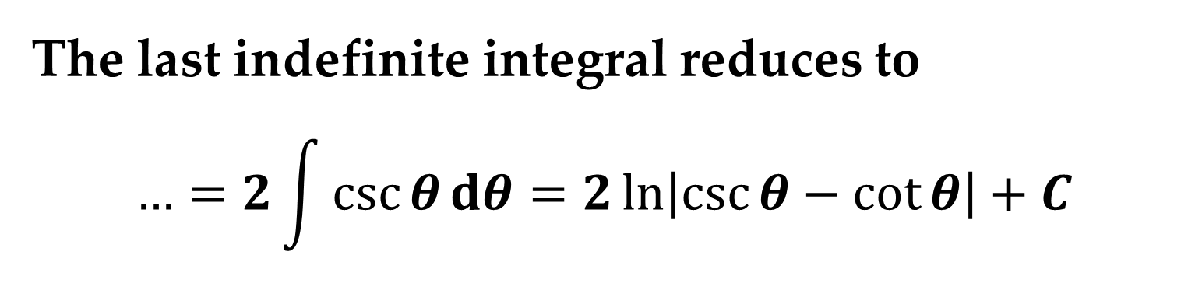


The last indefinite integral reduces to
$$…=2\int{\csc{θ}dθ}=2\ln\left|\csc{θ}−\cot{θ}\right|+C$$
$$…=2\ln\left|\frac{2x−5}{2\sqrt{x^{2}−5x+6}}−\frac{1}{2\sqrt{x^{2}−5x+6}}\right|+C$$
$$…=2\ln\left|\frac{x−3}{\sqrt{x^{2}−5x+6}}\right|+C$$
$$…=\ln\left|\frac{{\left(x−3\right)}^{2}}{x^{2}−5x+6}\right|+C$$

Slide 8
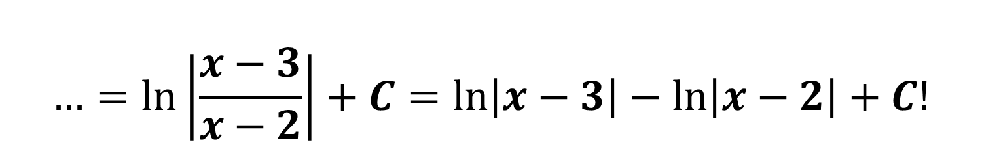

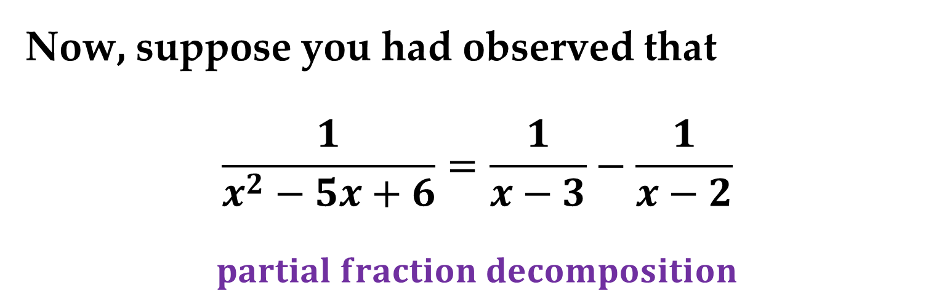
$$…=\ln\left|\frac{{\left(x−3\right)}^{2}}{\left(x−2\right)\left(x−3\right)}\right|+C$$
$$…=\ln\left|\frac{x−3}{x−2}\right|+C=\ln\left|x−3\right|−\ln\left|x−2\right|+C!$$
Now, suppose you had observed that
$$\frac{1}{x^{2}−5x+6}=\frac{1}{x−3}−\frac{1}{x−2}$$
$$partial fraction decomposition$$

Slide 9

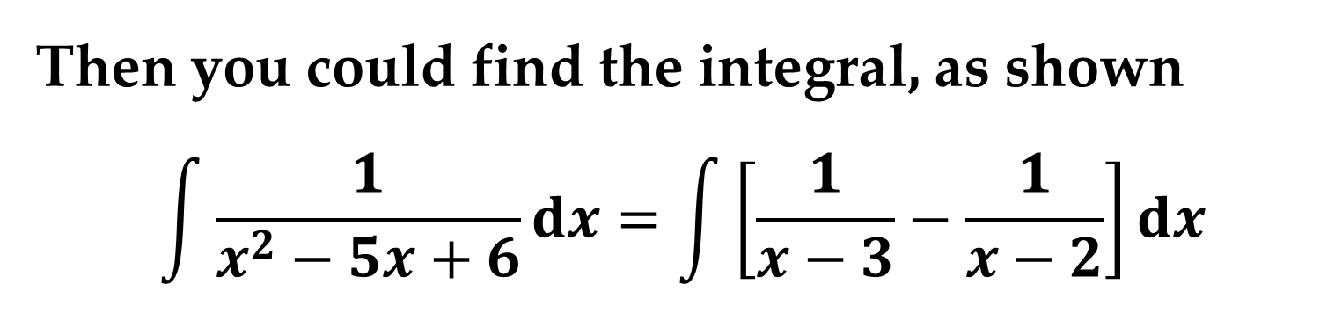
Then you could find the integral, as shown
$$\int{\frac{1}{x^{2}−5x+6}dx}=\int{\left[\frac{1}{x−3}−\frac{1}{x−2}\right]dx}$$
$$…=\int{\frac{1}{x−3}dx}−\int{\frac{1}{x−2}dx}$$
$$…=\ln\left|x−3\right|−\ln\left|x−2\right|+C$$
This method is clearly preferable to trigonometric substitution.

Slide 10
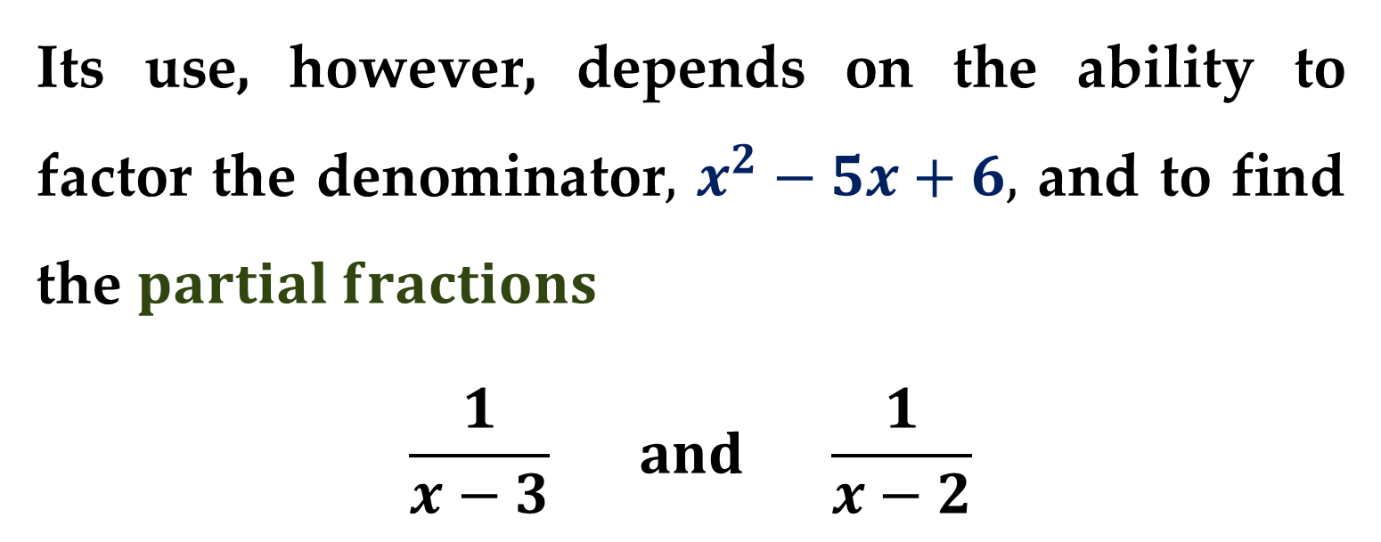
Its use, however, depends on the ability to factor the denominator$,$ $x^{2}−5x+6,$ and to find the $partial fractions$
$$\frac{1}{x−3} and \frac{1}{x−2}$$
In this section, you will study techniques for finding partial fraction decompositions.

Slide 11
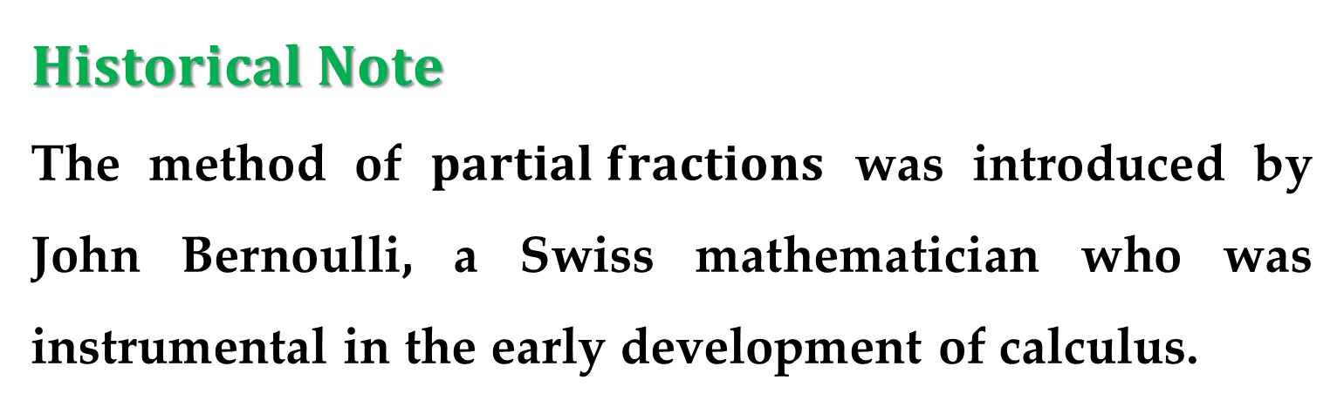
$Historical Note$
The method of $partial fractions$ was introduced by John Bernoulli, a Swiss mathematician who was instrumental in the early development of calculus.
John Bernoulli was a professor at the University of Basel and taught many outstanding students, the most famous of whom was Leonhard Euler.

Slide 12
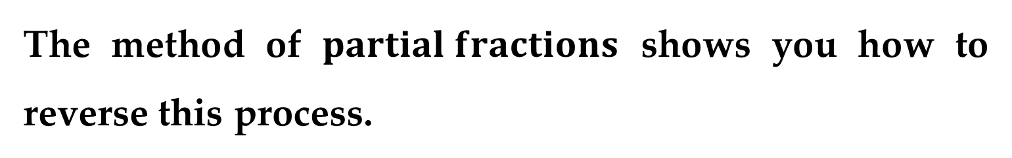
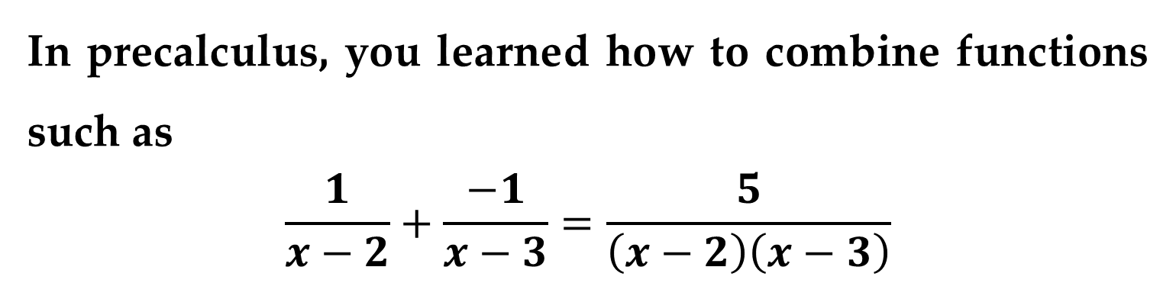
Recall from algebra that every polynomial with real coefficients can be factored into linear and irreducible quadratic factors.
In precalculus, you learned how to combine functions such as
$$\frac{1}{x−2}+\frac{−1}{x−3}=\frac{5}{\left(x−2\right)\left(x−3\right)}$$
The method of $partial fractions$ shows you how to reverse this process.

Slide 13

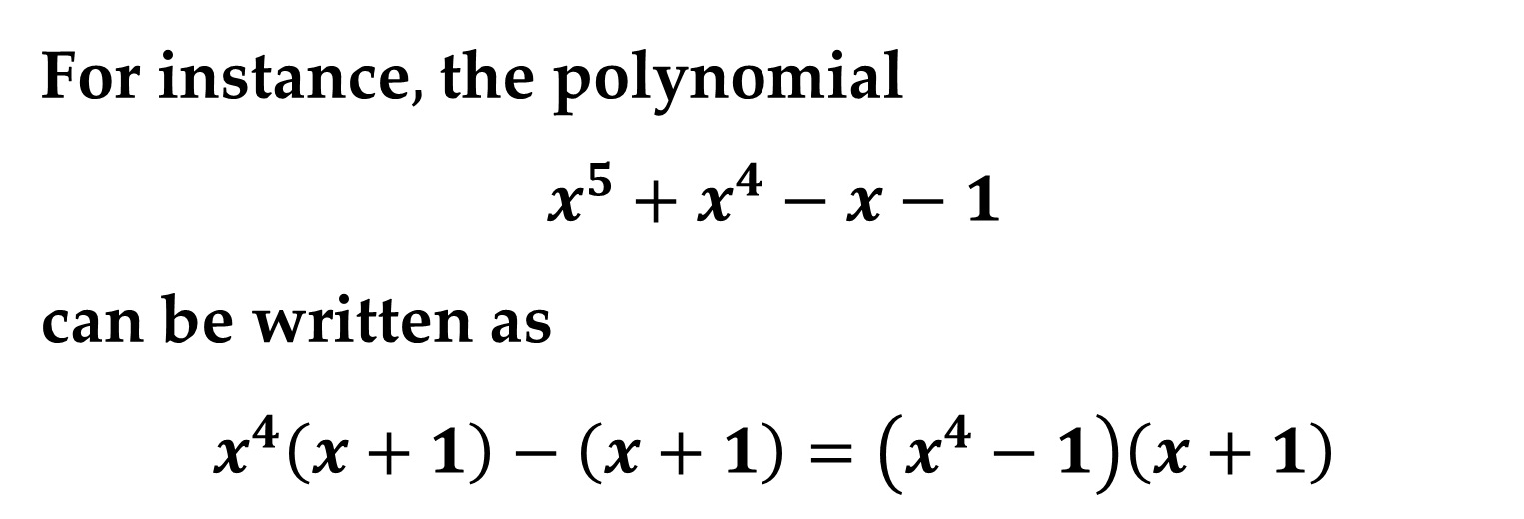


For instance$,$ the polynomial
$$x^{5}+x^{4}−x−1$$
can be written as
$$x^{4}\left(x+1\right)−\left(x+1\right)=\left(x^{4}−1\right)\left(x+1\right)$$
$$…=\left(x^{2}+1\right)\left(x^{2}−1\right)\left(x+1\right)$$
$$…=\left(x^{2}+1\right)\left(x−1\right)\left(x+1\right)\left(x+1\right)$$
$$…=\left(x−1\right){\left(x+1\right)}^{2}\left(x^{2}+1\right)$$

Slide 14
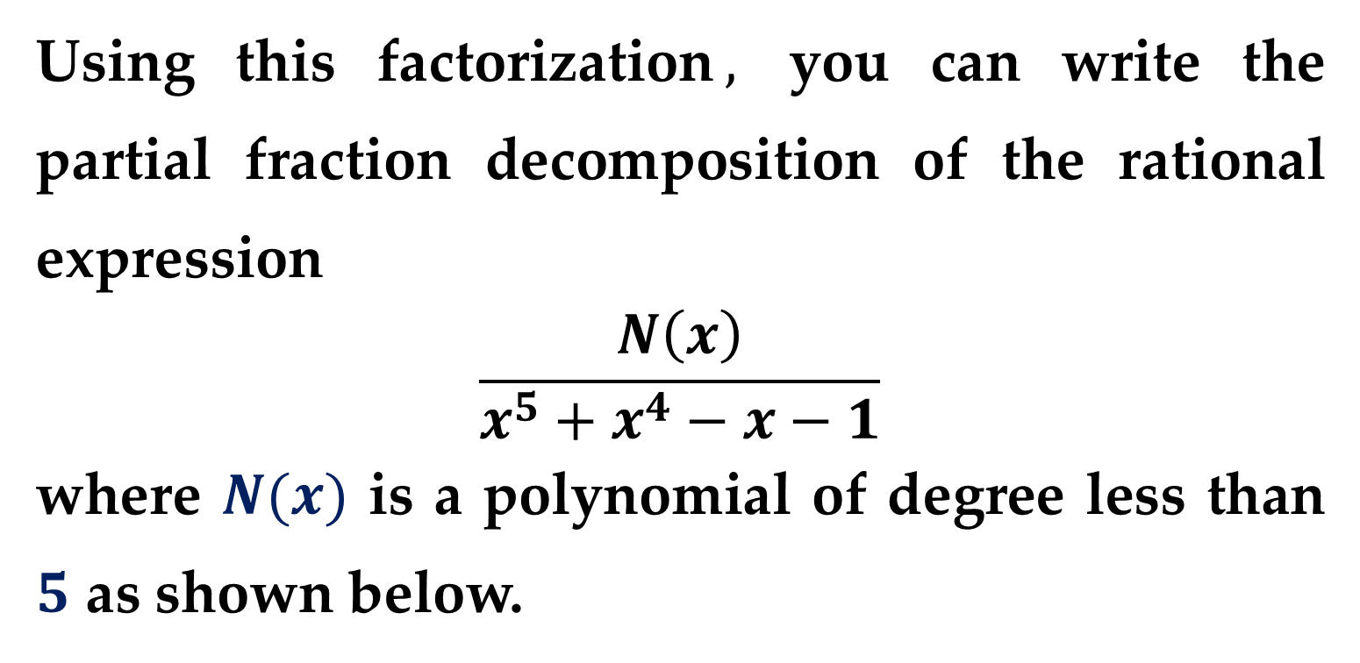
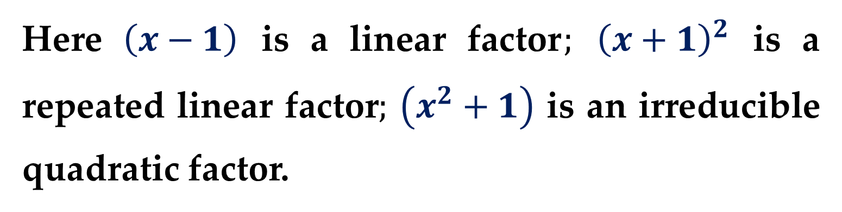
Here $\left(x−1\right)$ is a linear factor$;$ ${\left(x+1\right)}^{2}$ is a repeated linear factor$;$ $\left(x^{2}+1\right)$ is an irreducible quadratic factor.
Using this factorization$,$ you can write the partial fraction decomposition of the rational expression
$$\frac{N\left(x\right)}{x^{5}+x^{4}−x−1}$$
where $N(x)$ is a polynomial of degree less than $5$ as shown below.

Slide 15
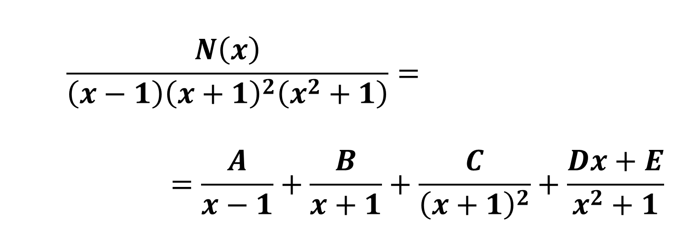
$$\frac{N\left(x\right)}{\left(x−1\right){\left(x+1\right)}^{2}\left(x^{2}+1\right)}=$$
$$=\frac{A}{x−1}+\frac{B}{x+1}+\frac{C}{{\left(x+1\right)}^{2}}+\frac{Dx+E}{x^{2}+1}$$
Based on the observations given above, we can propose the following decomposition scheme of rational functions into partial fractions.

Slide 16
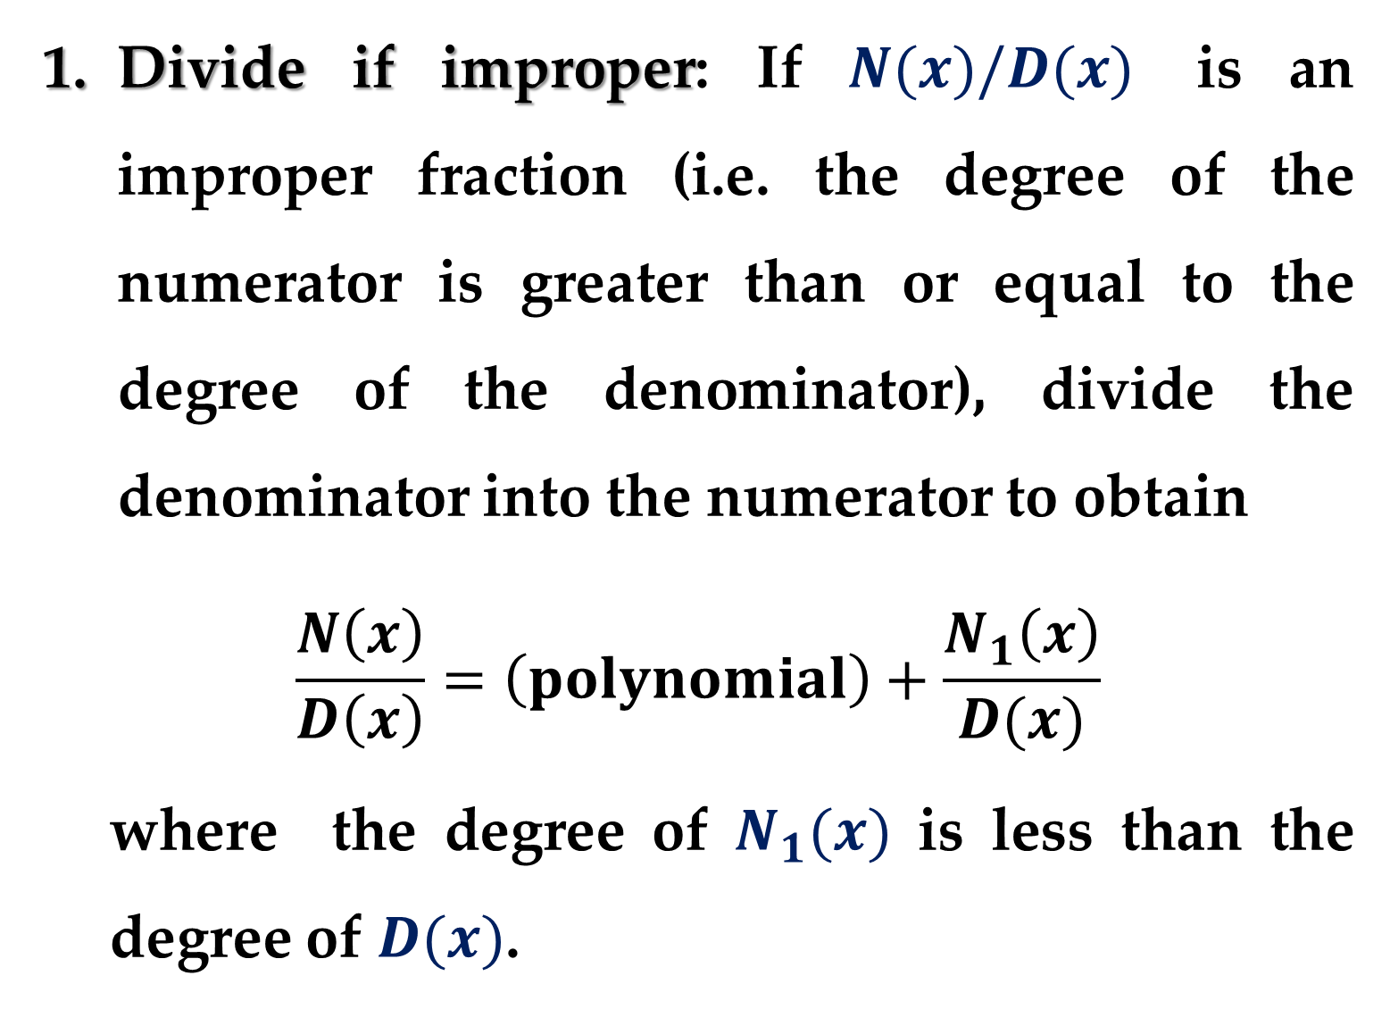
Divide if improper: If $N(x)/D(x)$ is an improper fraction (i.e. the degree of the numerator is greater than or equal to the degree of the denominator), divide the denominator into the numerator to obtain
$$\frac{N\left(x\right)}{D\left(x\right)}=\left(polynomial\right)+\frac{N_{1}\left(x\right)}{D(x)}$$
where the degree of $N_{1}(x)$ is less than the degree of $D(x)$.

Slide 17
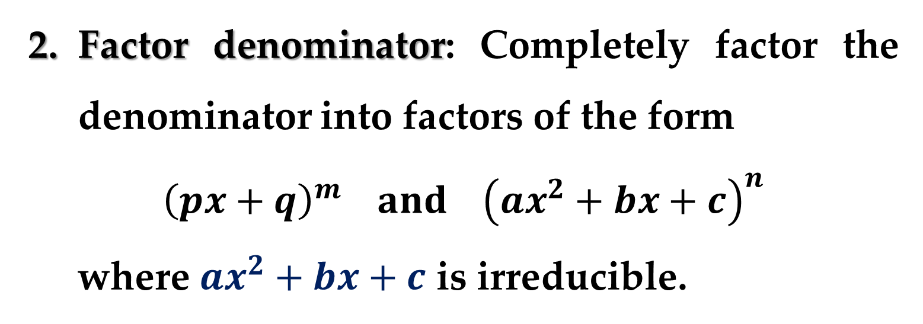
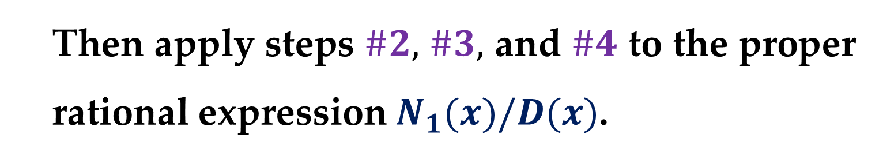
Then apply steps $\#2,$ $\#3,$ and $\#4$ to the proper rational expression $N_{1}(x)/D(x)$.
Factor denominator: Completely factor the denominator into factors of the form
$${\left(px+q\right)}^{m} and {\left(ax^{2}+bx+c\right)}^{n}$$
where $ax^{2}+bx+c$ is irreducible.

Slide 18
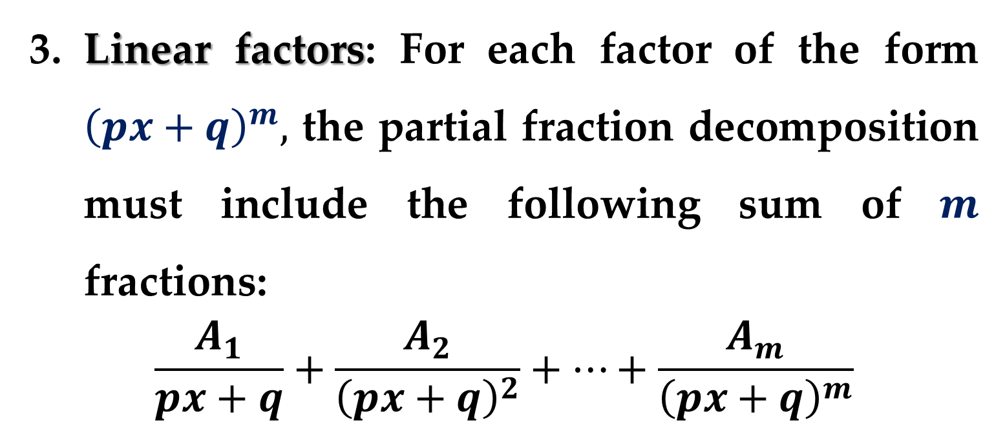
Linear factors: For each factor of the form ${\left(px+q\right)}^{m},$ the partial fraction decomposition must include the following sum of $m$ fractions:
$$\frac{A_{1}}{px+q}+\frac{A_{2}}{{\left(px+q\right)}^{2}}+…+\frac{A_{m}}{{\left(px+q\right)}^{m}}$$

Slide 19
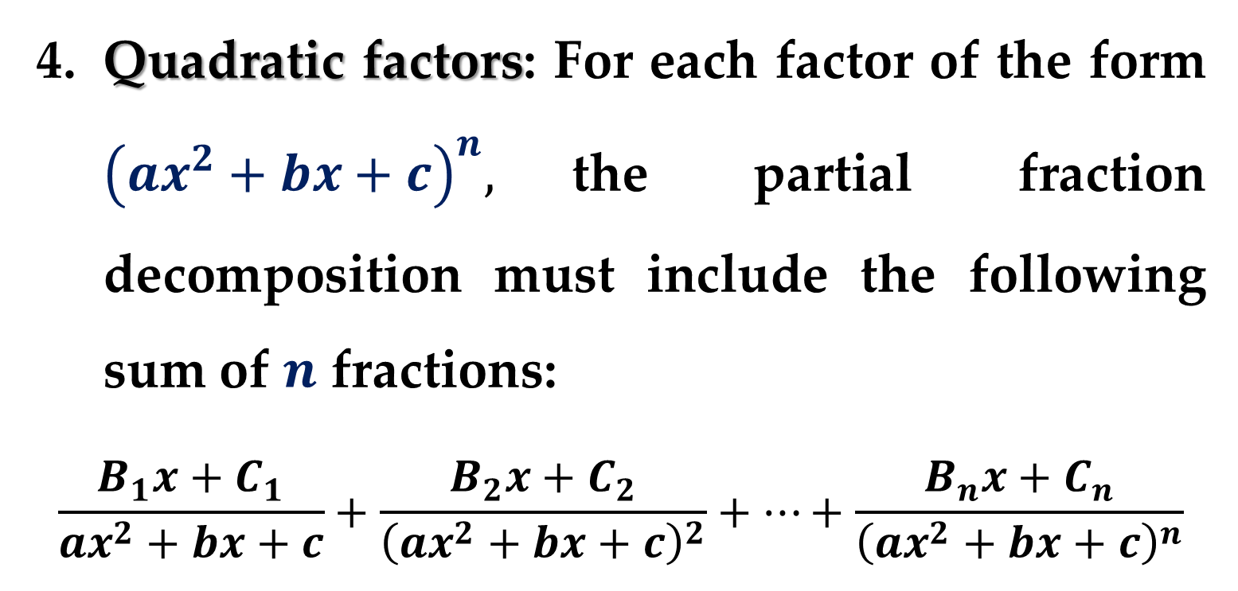
Quadratic factors: For each factor of the form ${\left(ax^{2}+bx+c\right)}^{n},$the partial fraction decomposition must include the following sum of $n$ fractions:
$$\frac{B_{1}x+C_{1}}{ax^{2}+bx+c}+\frac{B_{2}x+C_{2}}{{\left(ax^{2}+bx+c\right)}^{2}}+…+\frac{B_{n}x+C_{n}}{{\left(ax^{2}+bx+c\right)}^{n}}$$

Slide 20
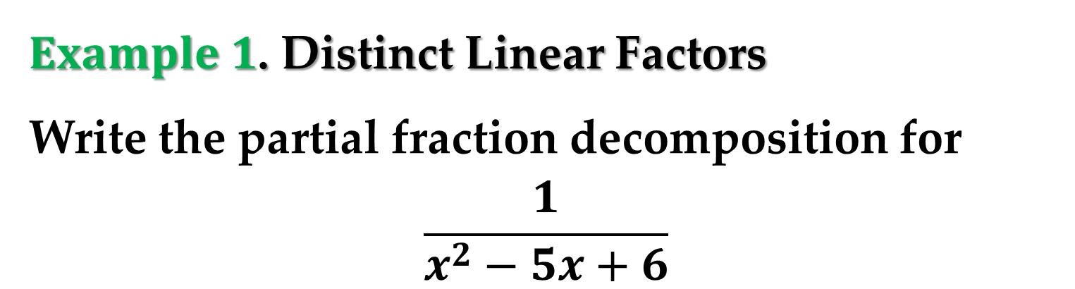
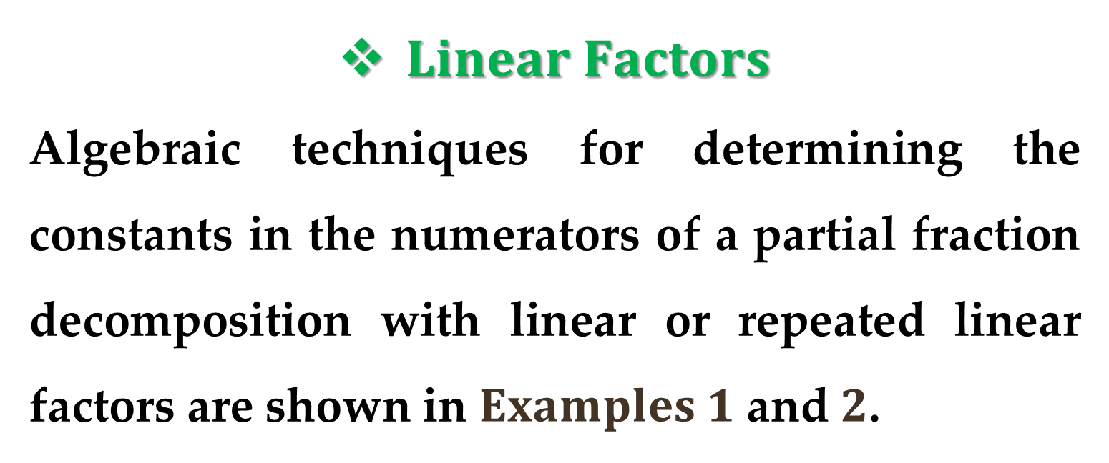
$Linear Factors$
Algebraic techniques for determining the constants in the numerators of a partial fraction decomposition with linear or repeated linear factors are shown in $Examples 1$ and $2$.
$Example 1$. Distinct Linear Factors
Write the partial fraction decomposition for
$$\frac{1}{x^{2}−5x+6}$$

Slide 21
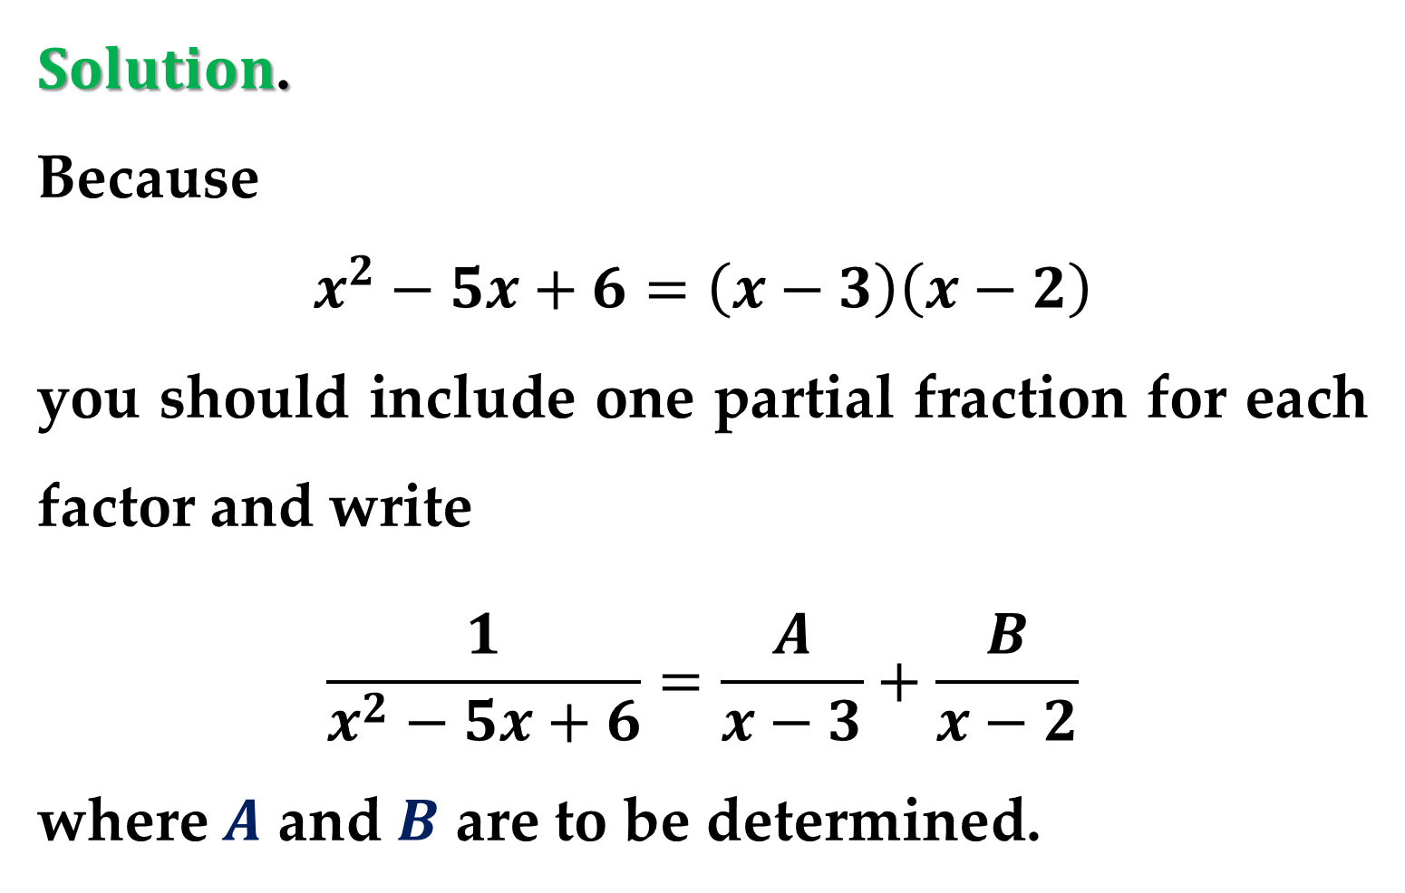
$Solution$.
Because
$$x^{2}−5x+6=\left(x−3\right)\left(x−2\right)$$
you should include one partial fraction for each factor and write
$$\frac{1}{x^{2}−5x+6}=\frac{A}{x−3}+\frac{B}{x−2}$$
where $A$ and $B$ are to be determined.

Slide 22
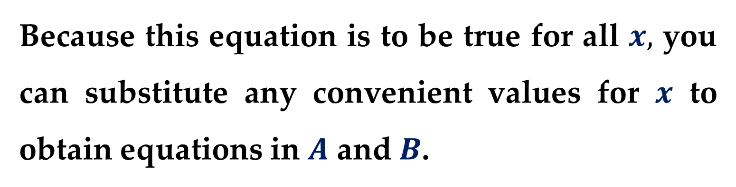
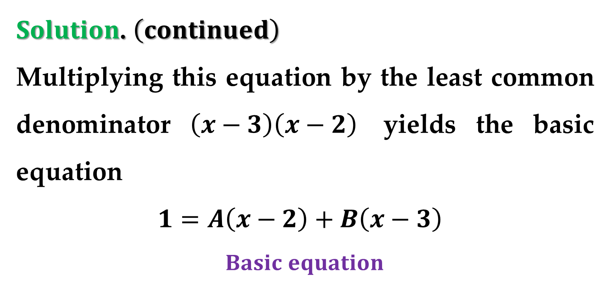
$Solution$. $\left(continued\right)$
Multiplying this equation by the least common denominator $\left(x−3\right)\left(x−2\right)$ yields the basic equation
$1=A\left(x−2\right)+B\left(x−3\right)$
$$Basic equation$$
Because this equation is to be true for all $x,$ you can substitute any convenient values for $x$ to obtain equations in $A$ and $B$.

Slide 23
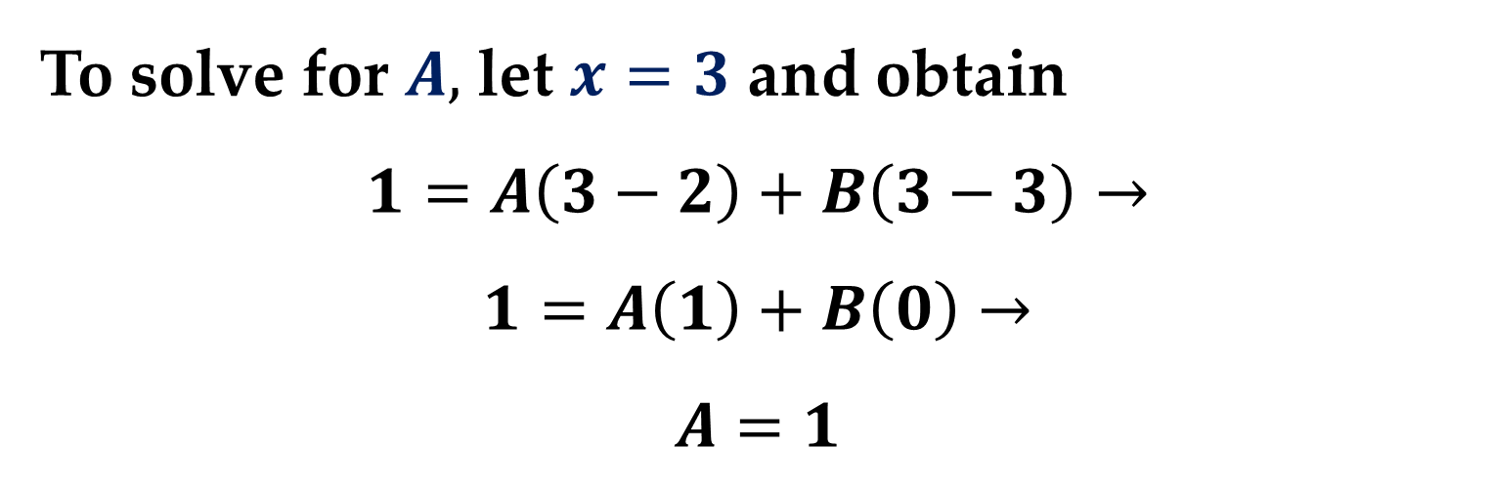
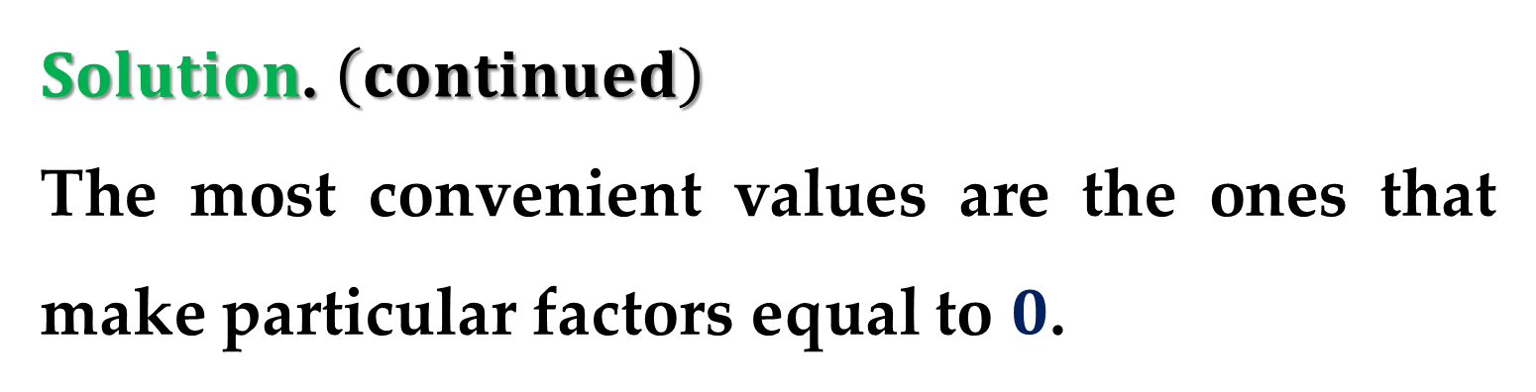
$Solution$. $\left(continued\right)$
The most convenient values are the ones that make particular factors equal to $0$.
To solve for $A,$ let $x=3$ and obtain
$$1=A\left(3−2\right)+B\left(3−3\right)→$$
$$1=A\left(1\right)+B\left(0\right)→$$
$$A=1$$

Slide 24
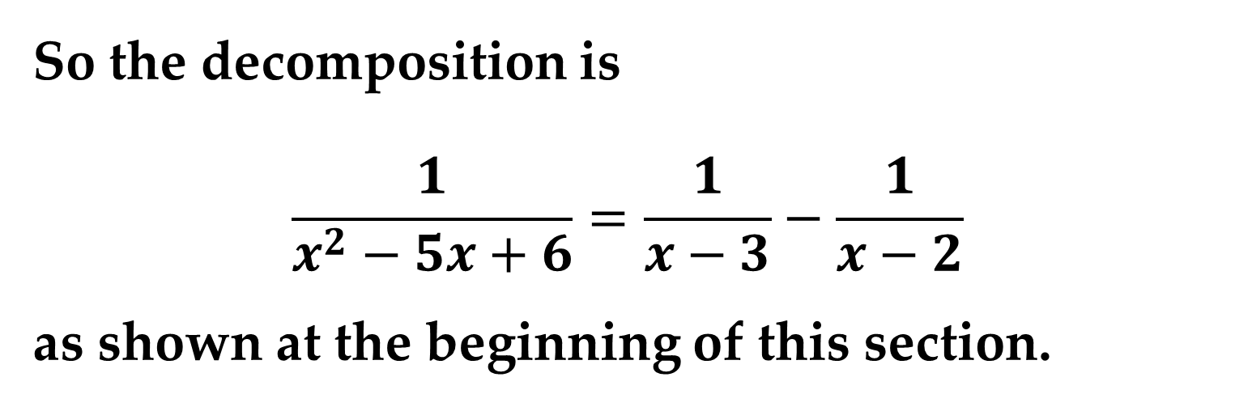
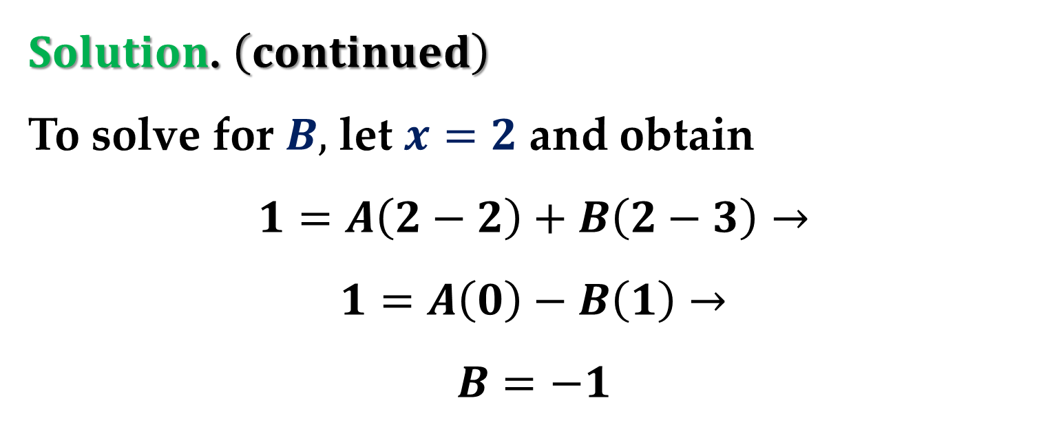
$Solution$. $\left(continued\right)$
To solve for $B,$ let $x=2$ and obtain
$$1=A\left(2−2\right)+B\left(2−3\right)→$$
$$1=A\left(0\right)−B\left(1\right)→$$
$$B=−1$$
So the decomposition is
$$\frac{1}{x^{2}−5x+6}=\frac{1}{x−3}−\frac{1}{x−2}$$
as shown at the beginning of this section.

Slide 25
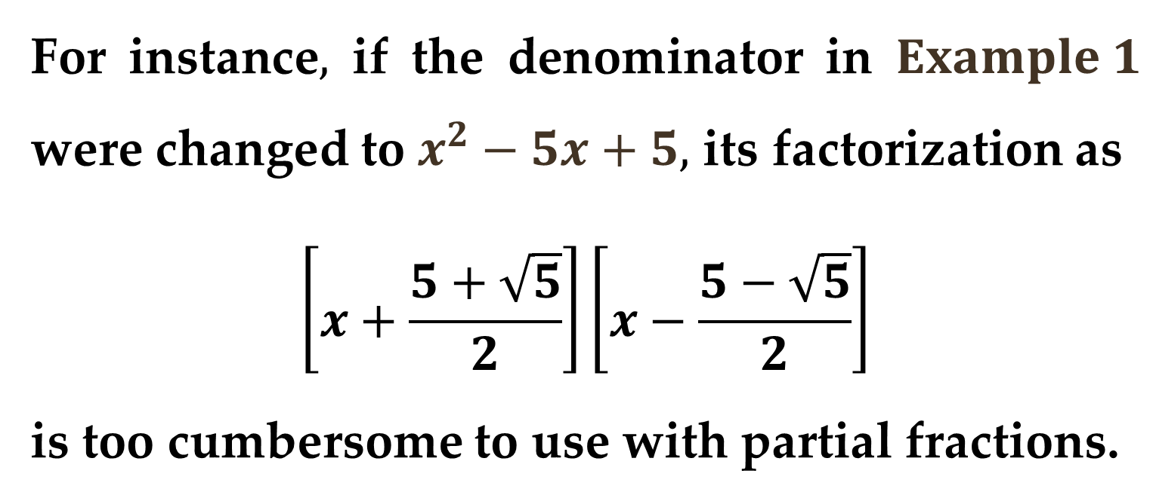
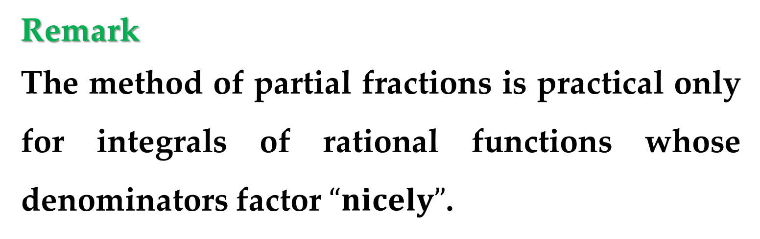
Remark
The method of partial fractions is practical only for integrals of rational functions whose denominators factor $“nicely”$.
For instance$,$ if the denominator in $Example 1$ were changed to $x^{2}−5x+5,$ its factorization as
$$\left[x+\frac{5+\sqrt{5}}{2}\right]\left[x−\frac{5−\sqrt{5}}{2}\right]$$
is too cumbersome to use with partial fractions.

Slide 26
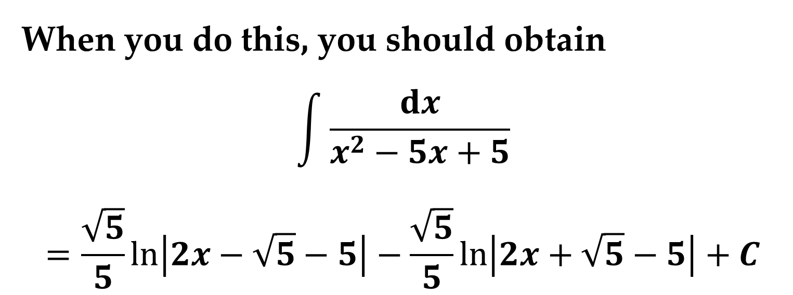
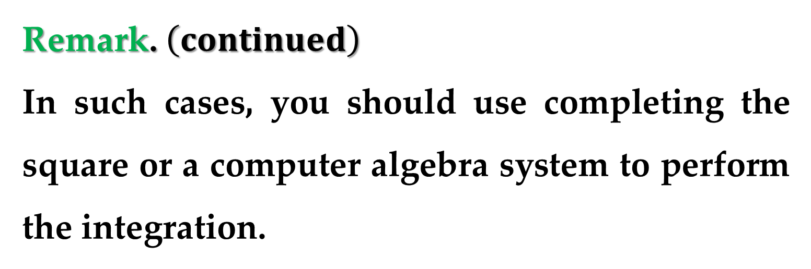
Remark. $\left(continued\right)$
In such cases, you should use completing the square or a computer algebra system to perform the integration.
When you do this, you should obtain
$$\int{\frac{dx}{x^{2}−5x+5}}$$
$$=\frac{\sqrt{5}}{5}\ln\left|2x−\sqrt{5}−5\right|−\frac{\sqrt{5}}{5}\ln\left|2x+\sqrt{5}−5\right|+C$$

Slide 27
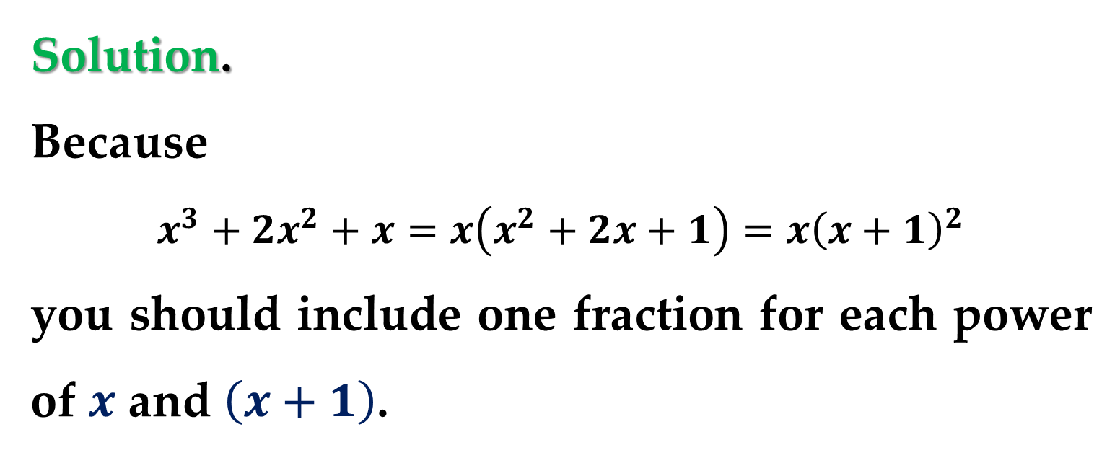
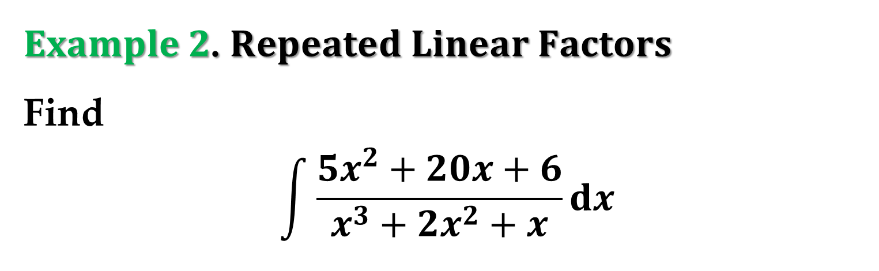
$Example 2$. $Repeated Linear Factors$
Find
$$\int{\frac{5x^{2}+20x+6}{x^{3}+2x^{2}+x}dx}$$
Solution.
Because
$$x^{3}+2x^{2}+x=x\left(x^{2}+2x+1\right)=x{\left(x+1\right)}^{2}$$
you should include one fraction for each power of $x$ and $\left(x+1\right)$.

Slide 28
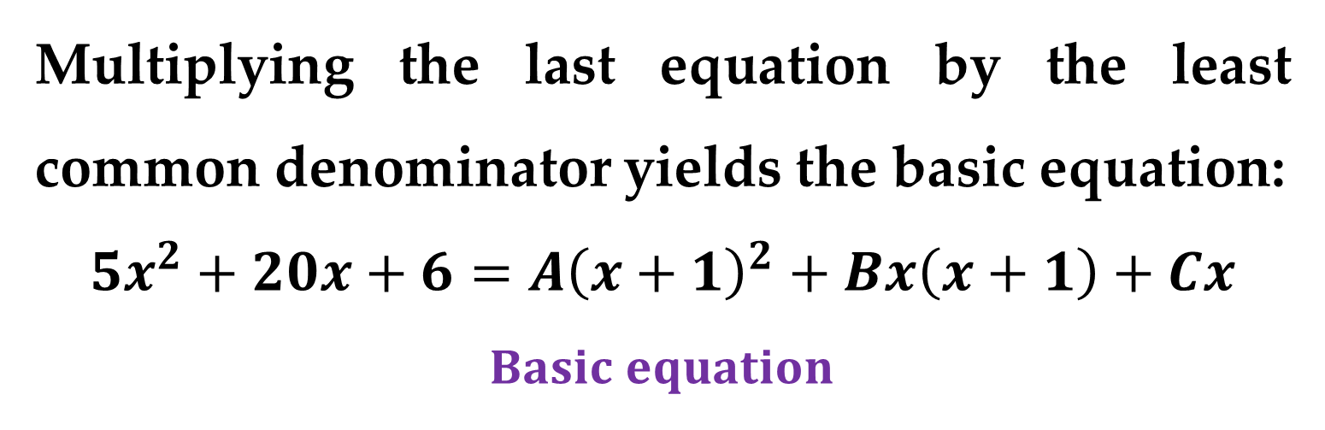
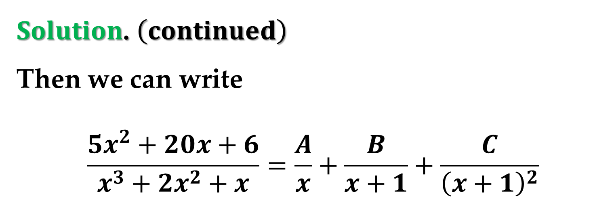
$Solution$. $\left(continued\right)$
Then we can write
$$\frac{5x^{2}+20x+6}{x^{3}+2x^{2}+x}=\frac{A}{x}+\frac{B}{x+1}+\frac{C}{{\left(x+1\right)}^{2}}$$
Multiplying the last equation by the least common denominator yields the basic equation:
$$5x^{2}+20x+6=A{\left(x+1\right)}^{2}+Bx\left(x+1\right)+Cx$$
$$Basic equation$$

Slide 29
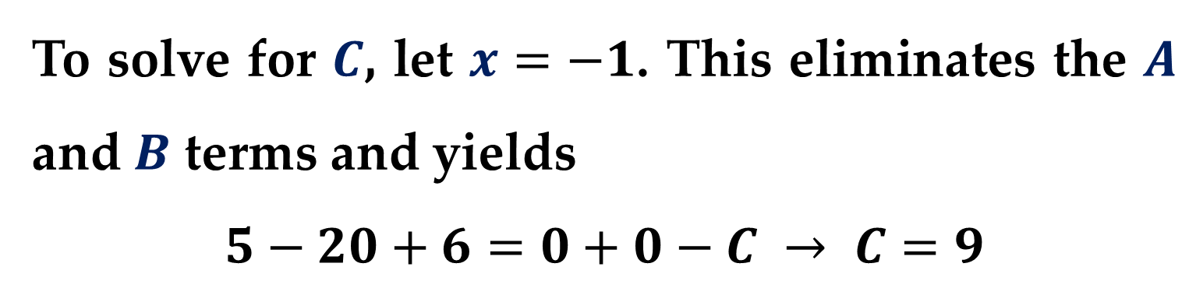
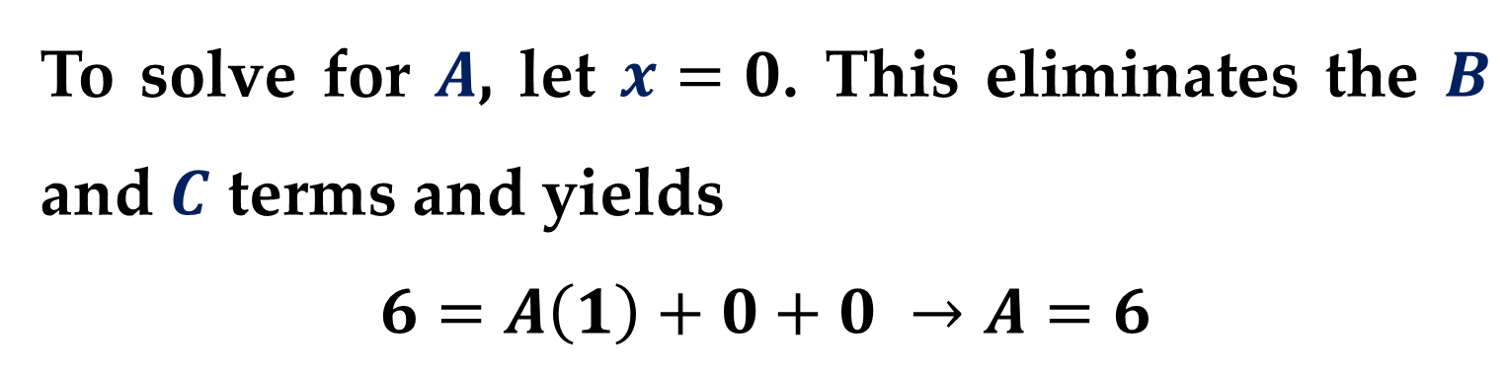
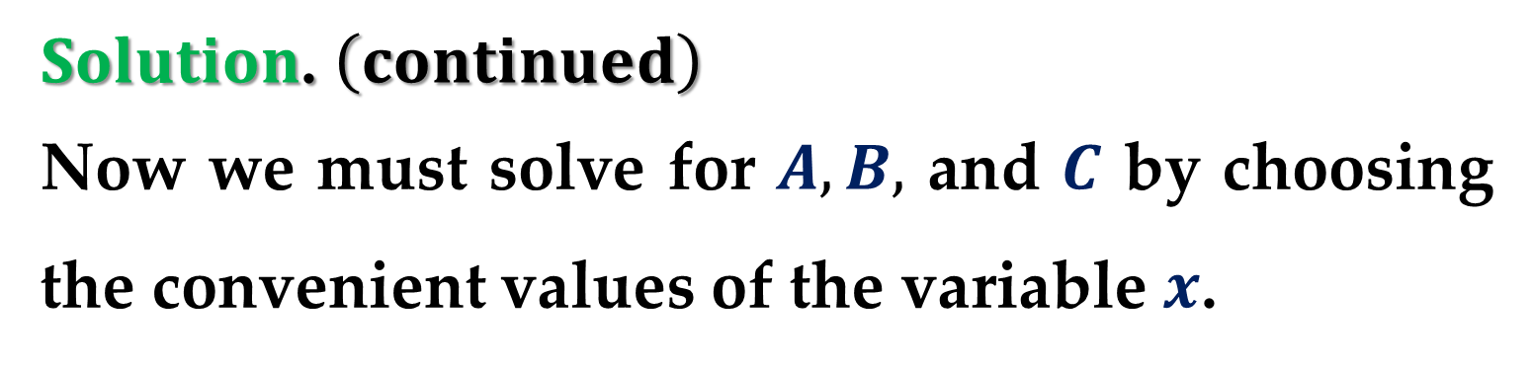
$Solution$. $\left(continued\right)$
Now we must solve for $A, B,$ and $C$ by choosing the convenient values of the variable $x$.
To solve for $A$, let $x=0$. This eliminates the $B$ and $C$ terms and yields
$$6=A\left(1\right)+0+0 →A=6$$
To solve for $C$, let $x=−1$. This eliminates the $A$ and $B$ terms and yields
$$5−20+6=0+0−C → C=9$$

Slide 30
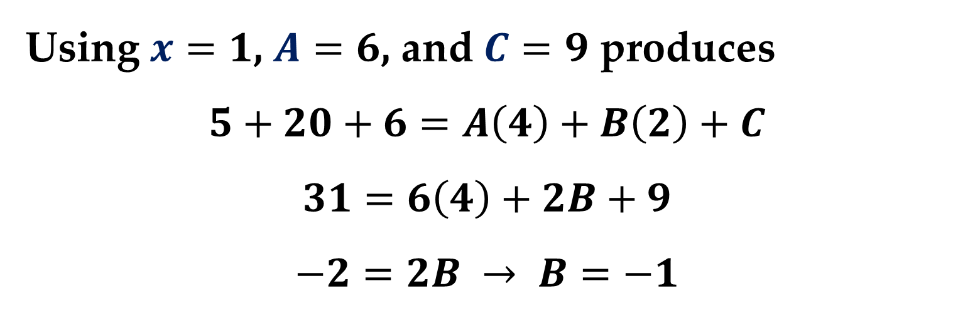
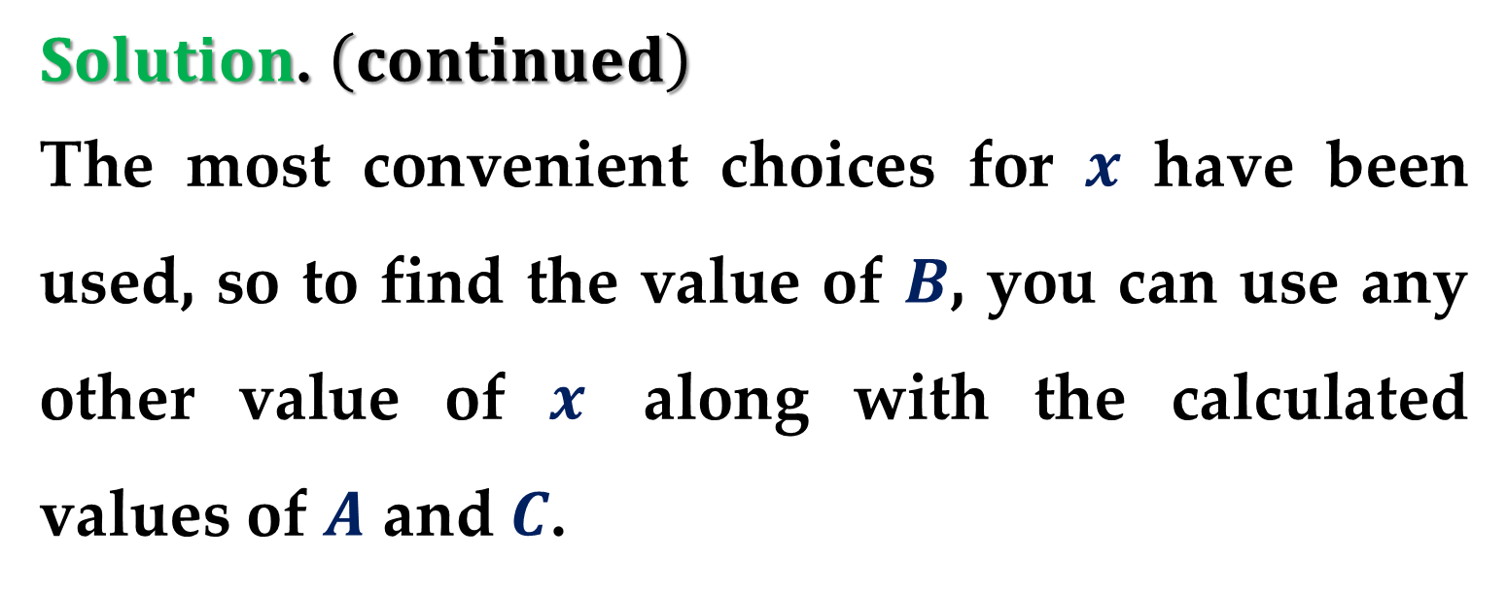
$Solution$. $\left(continued\right)$
The most convenient choices for $x$ have been used, so to find the value of $B$, you can use any other value of $x$ along with the calculated values of $A$ and $C$.
Using $x=1$, $A=6$, and $C=9$ produces
$$5+20+6=A\left(4\right)+B\left(2\right)+C$$
$$31=6\left(4\right)+2B+9$$
$$−2=2B → B=−1$$

Slide 31
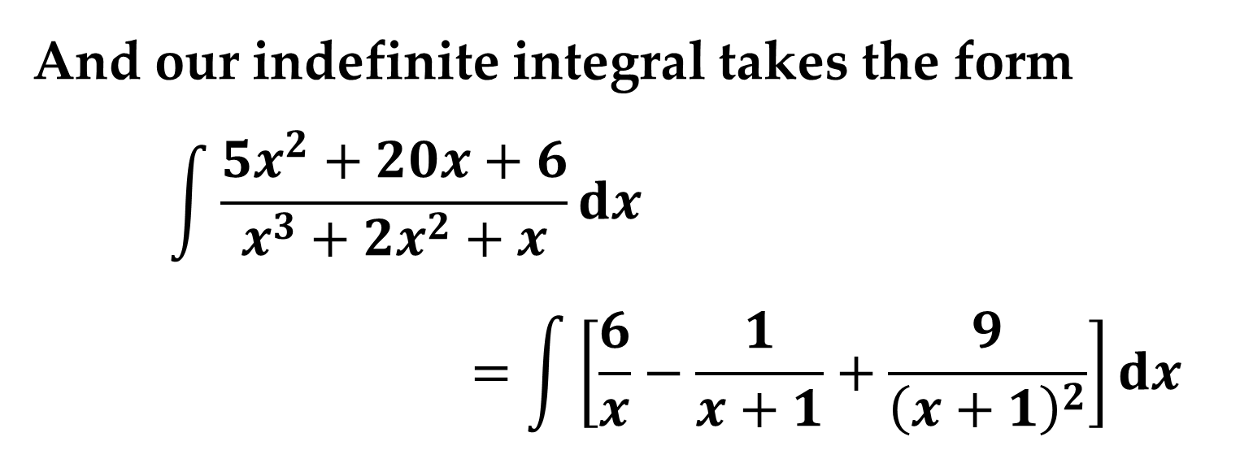

$Solution$. $\left(continued\right)$
So, it follows that
$$\frac{5x^{2}+20x+6}{x^{3}+2x^{2}+x}=\frac{6}{x}+\frac{−1}{x+1}+\frac{9}{{\left(x+1\right)}^{2}}$$
And our indefinite integral takes the form
$$\int{\frac{5x^{2}+20x+6}{x^{3}+2x^{2}+x}dx}$$
$$=\int{\left[\frac{6}{x}−\frac{1}{x+1}+\frac{9}{{\left(x+1\right)}^{2}}\right]dx}$$

Slide 32
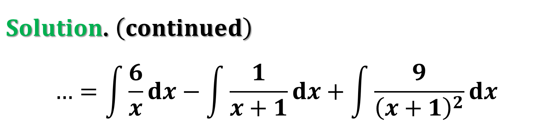

$Solution$. $\left(continued\right)$
$$…=\int{\frac{6}{x}dx}−\int{\frac{1}{x+1}dx}+\int{\frac{9}{{\left(x+1\right)}^{2}}dx}$$
$$…=6\ln\left|x\right|−\ln\left|x+1\right|−9{\left(x+1\right)}^{−1}+C$$
$$…=\ln\left|\frac{x^{6}}{x+1}\right|−\frac{9}{x+1}+C$$
Try checking this result by differentiating. Include algebra in your check, simplifying the derivative until you have obtained the original integrand.

Slide 33


Technology Note
Most computer algebra systems such as MatLab$,$ Maple$,$ and Mathematica can be used to convert a rational function to its partial fraction decomposition.
For instance, using $Mathematica$, you obtain the partial fraction decomposition by invoking
Apart[(5x^2+20x+6)/(x^3+2x^2+x),x]

Slide 34


Remark
It is necessary to make as many substitutions for $x$ as there are unknowns to be determined:
$$A, B, C, …$$
For instance, in $Example 2$, three substitutions ($x=0$, $x=−1$, and $x=1$) were made to solve for $A$, $B$, and $C$.

Slide 35


$Quadratic Factors$
When using the method of partial fractions with linear factors, a convenient choice of $x$ immediately yields a value for one of the unknown coefficients: $A, B, C, …$ .
With quadratic factors, a system of linear equations usually has to be solved, regardless of the choice of $x$.

Slide 36


$Example 3$. $Distinct Linear and Quadratic$
$$Factors$$
Find
$$\int{\frac{2x^{3}−4x−8}{\left(x^{2}−x\right)\left(x^{2}+4\right)}dx}$$
Solution
We can factor the denominator as follows:
$$\left(x^{2}−x\right)\left(x^{2}+4\right)=x\left(x−1\right)\left(x^{2}+4\right)$$

Slide 37


$Solution$. $\left(continued\right)$
Therefore, you should include one partial fraction for each factor and write
$$\frac{2x^{3}−4x−8}{\left(x^{2}−x\right)\left(x^{2}+4\right)}=\frac{A}{x}+\frac{B}{x−1}+\frac{Cx+D}{x^{2}+4}$$
Multiplying by the least common denominator $x\left(x−1\right)\left(x^{2}+4\right)$ yields the $basic equation$:
$$2x^{3}−4x−8=A\left(x−1\right)\left(x^{2}−4\right)+Bx\left(x^{2}+4\right)+$$
$+\left(Cx+D\right)\left(x\right)\left(x−1\right)$

Slide 38




$Solution$. $\left(continued\right)$
To solve for $A,$ let $x=0$ and obtain $A=2$.
To solve for $B,$ let $x=1$ and obtain $B=−2$.
At this point$,$ $C$ and $D$ are yet to be determined.
You can find these constants by choosing two other values for $x$ and solving the resulting system of linear equations.

Slide 39



$Solution$. $\left(continued\right)$
If $x=−1,$ then$,$ using $A=2$ and $B=−2,$ you can write: $2=−C+D$.
If $x=2,$ you have: $8=2C+D$.
Solving the following linear system of equations
$$−C+D=2$$
$$2C+D=8$$
yields $C=2$ and $D=4$.

Slide 40


$Solution$. $\left(continued\right)$
It follows that
$$\frac{2x^{3}−4x−8}{\left(x^{2}−x\right)\left(x^{2}+4\right)}=\frac{2}{x}−\frac{2}{x−1}+\frac{2x}{x^{2}+4}+\frac{4}{x^{2}+4}$$
Therefore
$$\int{\frac{2x^{3}−4x−8}{\left(x^{2}−x\right)\left(x^{2}+4\right)}dx}$$
$$=2\ln\left|x\right|−2\ln\left|x−1\right|+\ln\left(x^{2}+4\right)+2\tan^{−1}{\frac{x}{2}}+C$$

Slide 41


$Example 4$. $Repeated Quadratic Factors$
Find
$$\int{\frac{8x^{3}+13x}{{\left(x^{2}+2\right)}^{2}}dx}$$
Solution.
Include one partial fraction for each power of $\left(x^{2}+2\right)$ and write
$$\frac{8x^{3}+13x}{{\left(x^{2}+2\right)}^{2}}=\frac{Ax+B}{x^{2}+2}+\frac{Cx+D}{{\left(x^{2}+2\right)}^{2}}$$

Slide 42


$Solution$. $\left(continued\right)$
Multiplying by the least common denominator ${\left(x^{2}+2\right)}^{2}$ yields the $basic equation$:
$$8x^{3}+13x=\left(Ax+B\right)\left(x^{2}+2\right)+\left(Cx+D\right)$$
Expanding the basic equation and collecting like terms produces
$$8x^{3}+13x=Ax^{3}+2Ax+Bx^{2}+2B+Cx+D$$
$$8x^{3}+13x=Ax^{3}+Bx^{2}+\left(2A+C\right)x+\left(2B+D\right)$$

Slide 43


$Solution$. $\left(continued\right)$
Now, you can equate the coefficients of like terms on opposite sides of the equation:

Slide 44


$Solution$. $\left(continued\right)$
Using the known values $A=8$ and $B=0,$ you can write
$$13=2A+C$$
$$0=2B+D$$
From this system$,$ we can find $C$ and $D$:
$$C=−3, D=0$$

Slide 45

$Solution$. $\left(continued\right)$
Finally, you can conclude that
$$\int{\frac{8x^{3}+13x}{{\left(x^{2}+2\right)}^{2}}dx}=\int{\left[\frac{8x}{x^{2}+2}+\frac{−3x}{{\left(x^{2}+2\right)}^{2}}\right]dx}$$
$$=4\ln\left(x^{2}+2\right)+\frac{1}{2}\frac{3}{x^{2}+2}+C$$

Slide 46

Remark
When integrating rational expressions$,$ keep in mind that for improper rational expressions such as
$$\frac{N\left(x\right)}{D\left(x\right)}=\frac{2x^{3}+x^{2}−7x+7}{x^{2}+x−2}$$
you must first divide to obtain
$$\frac{N\left(x\right)}{D\left(x\right)}=2x−1+\frac{−2x}{x^{2}+x−2}$$

Slide 47

$Remark$. $\left(continued\right)$
The proper rational expression is then decomposed into its partial fractions by the usual methods.
Below are some guidelines for solving the basic equation that is obtained in a partial fraction decomposition.

Slide 48


$$Guidelines for Solving the Basic Equation$$
$Linear Factors$
Substitute the roots of the distinct linear factors in the basic equation.
For repeated linear factors, use the coefficients determined in the first guideline to rewrite the basic equation.
Then substitute other convenient values of $x$ and solve for the remaining coefficients.

Slide 49



$Quadratic Factors$
Expand the basic equation.
Collect terms according to powers of $x$.
Equate the coefficients of like powers to obtain a system of linear equations involving $A$, $B$, $C$, and so on.
Solve the system of linear equations.

Slide 50


Before concluding this lecture, here are a few things you should remember.
First$,$ it is not necessary to use the partial fractions technique on all rational functions.
For instance, the following integral is evaluated more easily by the Log Rule:
$$\int{\frac{x^{2}+1}{x^{3}+3x−4}}dx=\frac{1}{3}\int{\frac{3x^{2}+3}{x^{3}+3x−4}}dx$$

Slide 51



Second$,$ if the integrand is not in reduced form$,$ reducing it may eliminate the need for partial fractions$,$ as shown in the following integral.
$$\int{\frac{x^{2}−x−2}{x^{3}−2x−4}dx}=\int{\frac{\left(x+1\right)\left(x−2\right)}{\left(x−2\right)\left(x^{2}+2x+2\right)}dx}$$
$$..=\int{\frac{x+1}{x^{2}+2x+2}dx}=\frac{1}{2}\int{\frac{2x+2}{x^{2}+2x+2}dx}$$

Slide 52

Finally, partial fractions can be used with some quotients involving transcendental functions.
For instance$,$ the substitution $u=\sin{x}$ allows you to write
$$\int{\frac{\cos{x}}{\sin{x}\left(\sin{x}−1\right)}dx}=\int{\frac{du}{u\left(u−1\right)}}$$

Slide 53
Thank you for attention

Slide 54

$Solution$. $\left(continued\right)$
text
text
text

